Slide 1
Agora Trading E-commerce Portal
Content
Wire Frame
Behat Features
Entity Relationship Diagram
Database Creation & Queries
Mock HTML / CSS Pages
Class Diagram

Slide 2
Wire Frame log in / sign up

Slide 3
<<header>>
Logo
Agora Trading
Login page
<<form>>
<<main>>
Username
<<Input>>
Password
<<Input>>
Forgot password?
Sign in
Sign up…
<<li>> or <<p>>
(Footer content)
<<footer>>

Slide 4
Header and footer same as sign in page**
<<form>>
Acc type
<<dropdown>>
First name
<<Input>>
Sign up page… once account type drop down option is chosen it will unhide either Business seller or buyer form. This is what Seller / buyer form will look like
Last name
<<Input>>
Address
<<Input>>
<<main>>
City
<<Input>>
Email
<<Input>>
Password
<<Input>>
Confirm pass
<<Input>>
Submit
Already have an account… Sign in

Slide 5
Header and footer same as sign in page**
<<dropdown>>
<<form>>
Acc type
<<main>>
Business name
<<Input>>
Sign up page… once Account type drop down option is chosen it will unhide either Business seller or buyer form. This is what Business form will look like
Registration #
<<Input>>
?
Link to info about NZ business registration
Logo
<<choose file>>
Bank #
<<Input>>
HQ Address
<<Input>>
HQ City
<<Input>>
Email
<<Input>>
Password
<<Input>>
Confirm pass
<<Input>>
Submit
Already have an account… Sign in

Slide 6
Wire frame Home page for all users

Slide 7
Business / buyer / seller News page (home page)
<<header>>
Logo
Log out
Agora Trading
News
Listings
Activity
Profile
<<nav>>
Some upcoming news about Agora
<<main>>
Description about the upcoming news that is happening. And what it means for your business.
<<li>> or <<p>>
(Footer content)
<<footer>>

Slide 8
Wire frame User - Seller

Slide 9
Seller all listing page
<<header>>
Logo
Log out
Agora Trading
News
Listings
Activity
Profile
<<nav>>
Seller’s Listings
New Listing
<<main>>
Search <<input>>
sort <<dropdown>>
Item name
Item name
Item name
Listing ‘cards’ are clickable (link to single listing page)
Price
Price
Price
In stock:
In stock:
In stock:
Item name
Item name
Item name
Price
Price
Price
In stock:
In stock:
In stock:
<<li>> or <<p>>
(Footer content)
<<footer>>

Slide 10
Seller single listing page
<<header>>
Logo
Log out
Agora Trading
News
Listings
Activity
Profile
<<nav>>
Item Name
<<main>>
Price
In Stock
Category
Description
Edit
Delete
<<li>> or <<p>>
(Footer content)
<<footer>>

Slide 11
Seller add new or edit listing page
<<header>>
Logo
Log out
Agora Trading
News
Listings
Activity
Profile
<<nav>>
<<main>>
name
<<input>>
description
<<input>>
Price
<<input>>
In stock
<<input>>
photo
<<Choose file>>
Category <<dropdown>>
Submit
<<li>> or <<p>>
(Footer content)
<<footer>>

Slide 12
Seller Activity page
<<header>>
Logo
Log out
Agora Trading
News
Listings
Activity
Profile
<<nav>>
Recently sold
<<main>>
Date
Item name
Price
Quantity
Buyer Business
Date
Item name
Price
Quantity
Buyer Business
<<Scrollable box>>
Date
Item name
Price
Quantity
Buyer Business
Date
Item name
Price
Quantity
Buyer Business
Date
Item name
Price
Quantity
Buyer Business
<<li>> or <<p>>
(Footer content)
<<footer>>

Slide 13

Seller Profile page
<<header>>
Logo
Log out
Agora Trading
News
Listings
Activity
Profile
<<nav>>
<<main>>
Business logo
First name
James
Last name
Hutchinson
email
jch233@arastudent.ac.nz
address
123 main street
city
Christchurch
password
**********
Confirm pass
**********
<<li>> or <<p>>
(Footer content)
<<footer>>

Slide 14
Wire frame User - Buyer

Slide 15

Buyer all listing page
<<header>>
Logo
Log out
Agora Trading
News
Listings
Activity
Profile
<<nav>>
Listings
<<main>>
Search <<input>>
sort <<dropdown>>
Category <<dropdown>>
Item name
Item name
Item name
Listing ‘cards’ are clickable (link to single listing page)
Price
Price
Price
In stock:
In stock:
In stock:
Item name
Item name
Item name
Price
Price
Price
In stock:
In stock:
In stock:
<<li>> or <<p>>
(Footer content)
<<footer>>

Slide 16
Buyer single listing page
<<header>>
Logo
Log out
Agora Trading
News
Listings
Activity
Profile
<<nav>>
Item Name
<<main>>
Price
Qty <<input>>
Seller Business
Description
Purchase
<<li>> or <<p>>
(Footer content)
<<footer>>

Slide 17

Buyer Cart / Checkout page
<<header>>
Logo
Log out
Agora Trading
News
Listings
Activity
Profile
<<nav>>
Purchased Items
<<main>>
Item name
Price
Quantity
Seller Business
Item name
Price
Quantity
Seller Business
<<Scrollable box>>
Item name
Price
Quantity
Seller Business
Item name
Price
Quantity
Seller Business
Sends invoice to business
Confirm
Total
<<li>> or <<p>>
(Footer content)
<<footer>>

Slide 18
Buyer Activity page
<<header>>
Logo
Log out
Agora Trading
News
Listings
Activity
Profile
<<nav>>
Recently bought
<<main>>
Date
Item name
Price
Quantity
Seller Business
Date
Item name
Price
Quantity
Seller Business
<<Scrollable box>>
Date
Item name
Price
Quantity
Seller Business
Date
Item name
Price
Quantity
Seller Business
Date
Item name
Price
Quantity
Seller Business
<<li>> or <<p>>
(Footer content)
<<footer>>

Slide 19
Buyer Profile page
<<header>>
Logo
Log out
Agora Trading
News
Listings
Activity
Profile
<<nav>>
<<main>>
Business logo
First name
James
Last name
Hutchinson
email
jch233@arastudent.ac.nz
address
123 main street
city
Christchurch
password
**********
Confirm pass
**********
<<li>> or <<p>>
(Footer content)
<<footer>>

Slide 20
Wire frame User - Business

Slide 21
Business all listing page
<<header>>
Logo
Log out
Agora Trading
News
Listings
Activity
Profile
<<nav>>
Listings
<<main>>
Search <<input>>
sort <<dropdown>>
Sellers <<dropdown>>
Item name
Item name
Item name
Listing ‘cards’ are clickable (link to single listing page)
Price
Price
Price
In stock:
In stock:
In stock:
Item name
Item name
Item name
Price
Price
Price
In stock:
In stock:
In stock:
<<li>> or <<p>>
(Footer content)
<<footer>>

Slide 22
Business single listing page
<<header>>
Logo
Log out
Agora Trading
News
Listings
Activity
Profile
<<nav>>
Item Name
<<main>>
Price
In Stock
Category
Description
<<li>> or <<p>>
(Footer content)
<<footer>>

Slide 23
Business Profile page
<<header>>
Logo
Log out
Agora Trading
News
Listings
Activity
Profile
<<nav>>
Business Name
Ara
<<main>>
Business logo
Users
Link to users page
Registration #
Hutchinson
email
abusiness@business.co.nz
Change logo
Bank #
05 67890 545564 00
HQ address
123 main street
HQ city
Christchurch
password
**********
Confirm pass
**********
address1
123 other street
city1
Auckland
Add new location
New location button will unhide a new address and city inputs
Footer here like previous wire frames (ran out of space)

Slide 24
Business users page
<<header>>
Logo
Log out
Agora Trading
News
Listings
Activity
Profile
<<nav>>
Users
username<<input>>
Invite User
<<main>>
Activity will link to the buyers/sellers activity page..
Buyer / Seller
profile
Buyer / Seller
profile
Buyer / Seller
profile
Full name
Activity
Full name
Activity
Full name
Activity
profile will link to the buyers/sellers profile page.. (without the edits displaying)
City
Delete
City
Delete
City
Delete
Buyer / Seller
profile
Buyer / Seller
profile
Buyer / Seller
profile
Full name
Activity
Full name
Activity
Full name
Activity
City
Delete
City
Delete
City
Delete
<<li>> or <<p>>
(Footer content)
<<footer>>

Slide 25
Behat Features

Slide 26
User – Buyer Feature: As a buyer I should be able to purchase items
Scenario – I purchase a box of stainless-steel screws for $80 shipping included
Given I have a buyer account
When I purchase the item
And checkout
And confirm purchase from the cart page
Then my business will get an invoice of $80
And the screws are sent to my address
Scenario – I purchase a motorbike for $8000 shipping included
Given I have a buyer account
But my business has overdue payments to the motorbike business
When I purchase the item
And checkout
And confirm purchase from the cart page
Then my business will get an email saying they won’t release the motorbike until debt is paid
And the purchase will be flagged

Slide 27
User – Seller Feature: As a seller I should be able to add items to my account to sell
Scenario – I add an item with all the required information
Given I have a seller account
When I input the item name, description, photo, price and quantity in stock
Then the item should be added to my account
Scenario – I add an item but do not input product price
Given I have a seller account
When I input the item name, description, photo and quantity in stock
Then an error message will be displayed stating required field “Price” needs to be input.

Slide 28
User – Business Admin Feature: As a Business Admin I should be able to invite sellers to link with my business account
Scenario – The seller accepts my invite to link with my business account
Given I have a business admin account
When I send an invite to a seller to link with my business account
And the seller accepts the invitation
Then the seller is now linked with my business account
Scenario – I invite a seller to link with my business account, but the seller is linked with a business account already.
Given I have a business admin account
When I send an invite to a seller to link with my business account
And the seller is already linked to another business account
Then an alert will prompt me that the seller is already linked to a business
And to try a different username

Slide 29
Entity Relationship Diagram

Slide 30
Design using Visio

Slide 31
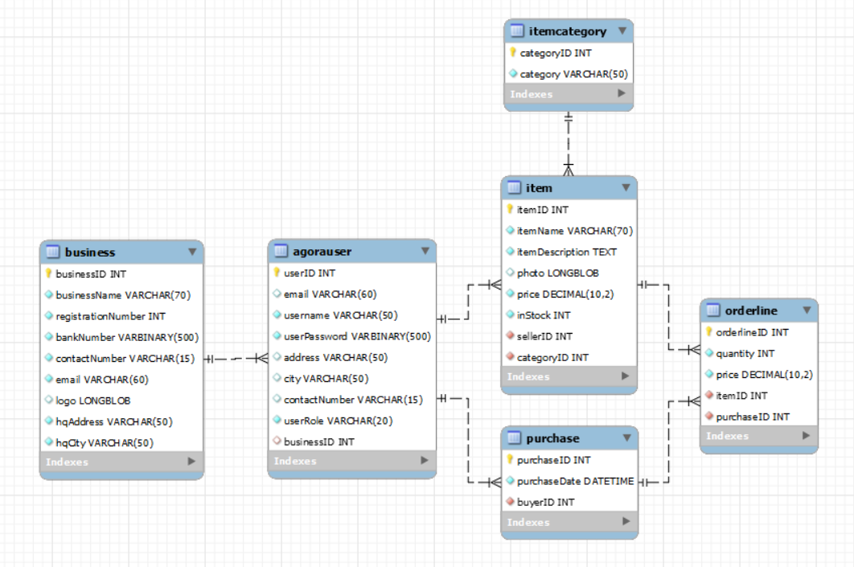
Reverse engineered ERD

